Slide 1

Activity summary of the consortium and expectations to new corporations
Open Data Promotion Consortium
Open Data Promotion Consortium
Deputy president Noboru Koshizuka

Slide 2
Open data Promotion Consortium
Establishment
  July, 2012
Purpose
  Infrastructure maintenance of open data promotion
Main activities
  Research activities (mainly, the technological standard and license)
  Promotional and educational activities (Distributing / sharing information and discussing new services etc.)
Membership
  Corporate members: 174 groups
  Local government members : 19 groups
  Expert members: 5 people

Slide 3
Consortium Committees

Slide 4
Technical Committee
The purpose
  Discuss technological standards necessary for open data promotion
Organization
  Chairperson
    Koshizuka (Professor, Interfaculty Initiative in Information Studies, The University of Tokyo, )
  Vice Chairperson
    Hideaki Takeda (Prof. National Institute of Information)
  Committee
    Akihiro Nakao (Prof. Interfaculty Initiative in Information Studies, The University of Tokyo,)
    Hiramoto (CIO assistant, Ministry of Economy, Trade and Industry)
    Yoshiaki Fukami, (Visiting Reseache, Keio Research Institute at SFC)
Outline of activities
  Discussing the technological specifications to promote various open data.
  Discussing work specifications for international standardization
  Discussing the system for long-term use operation of the open data

Slide 5
Data Governance Committee
Purpose
  Discuss user rule necessary for open data promotion.
Organization
  Chairperson
    Yuriko Inoue (Professor, Hitotsubashi University Graduate School of International Corporate Strategy)
  Vice Chairperson
    Yuko Noguchi (Head of Legal at Google Japan Inc. / Lawyer)
  Committee
    Toshiko Sawada (Director, EC Network)
    Fumito Tomooka (Professor, Nihon University College of Law)
    Ryoji Mori (Cyber Law Japan Eichi Law Offices Partner / Lawyer)
  Observer
    Ministry of Internal Affairs and Communications, Cabinet Secretariat, Ministry of Economy, Trade and Industry, Ministry of Land, Infrastructure and Transport
Outline of activities
  Discussing construction of open data of public data.
  Discussing the user rule of homepage for each prefecture corresponding to the open data.

Slide 6
Utilization and Promotion Committee
Purpose
  Distributing and sharing information on open data promotion.
  Discussing new services created from open data promotion.
Organization
  Chairperson
    Ichiya Nakamura (Professor, Graduate School of Media Design, Keio University)
  Vice Chairperson
    Fumihiro Murakami (Chief Researcher, Social ICT Solutions Division, Mitsubishi Research Institute, Inc.)
  Committee
    Yusho Ishikawa (Project Professor, Interfaculty Initiative in Information Studies, The University of Tokyo)
    Ikki Ohmukai (Associate Professor, National Institute of Information)
    Hiroichi Kawashima (President, Institute for Public Sector Innovation)
    Iwao Kobayashi (Representative director, Scholex)
    Masahiko Shoji (Senior Research Fellow / Assistant Professor, Center for Global Communications, International University of Japan)
    Sawako Nohara (President and CEO, IPSe Marketing, Inc. / Project Professor, Graduate School of Media and Governance, Keio University)
    Taisuke Fukuno (President and CEO, jig.jp)
  Observer
    Cabinet Secretariat, Ministry of Internal Affairs and Communications ,Ministry of Economy, Trade and Industry, Ministry of Land, Infrastructure, Transport and Tourism, Ministry of Agriculture, Forestry and Fisheries, Japan Business Federation, ASP-SaaS-Cloud CONSORTIUM, Etc.
Outline of activities
  Distributing information by a portal site.
  Organizing Ideathon/Hackathon/勝手表彰/symposium/contest et.
  Discussing the business model.

Slide 7
Technical Committee
Data Governance Committee

Slide 8

Outcome of technical committee and data governance committee
Creating and releasing the open data guide version1
Creating and publishing the external specification for the Information promotion collaboration platform system
Inputting into the electronic administration open data working level meeting.
  Technical guide for data creation to deliver the open data.
  The CSV format data standard for creation of open data
  Recommendation to terms of use for secondary use promotion of public data
  Open data guide, version 1

Slide 9
Utilization and Promotion Committee

Slide 10
Events held by the consortium
Date | Title | Outline
2012.11.05～12.01 | Meteorological Data/Ideathon | Held on Facebook with the cooperation of the Meteorological Agency, more than 100 participants.
2012.12.01 | Meteorological Data Hackathon | Held at MRI meeting room based on the results collected at the Ideathon event with about 50 participants.
2012.12.10 | Open Data Symposium | Held at The Ito Hall, the University of Tokyo. Co-hosted by Ministry of Internal Affairs and Communications, with About 260 participants.
2013.01.22～03.06 | Recruitment and evaluation of Japan Open Data Award | Evaluation and selection by the Utilization and Promotion Committee in consideration of 76 project works collected by the secretariat.
2013.03.13 | Japan Open Data Award & award ceremony | Awarded 13 groups as Japan Open Data Award
2013.10.02 | Open Data for Future～discussion of open data from the view point of developers～ | Necessary function and activities were discussed to make the open data easier to utilize from the view point of developers aiming at formation of a developer community. Government, ministries, agencies and 11 groups were participated.
2013.11.09 | Open data Ideathon（Hosted by METI/MIC) | Held at Knowledge Capital, Grand Front Osaka, with 50 participants.
2013.11.21 |  | Held at Komaba Research Campus, the University of Tokyo, with about 80 participants.
2013.11.26 |  | Held at Matsue Open Source Lab, with about 40 participants.
2013.12.09 | The Open Data Symposium | Held at The Ito Hall, the University of Tokyo, co-hosted by Ministry of Internal Affairs and Communications, with about 260 participants.
2014.02.07 | Use Case Contest | Held in Tokyo International Forum. There were applications of 48 works.
2014.01～03 | Open Data Application Contest | Public subscription of application developments that linked seven kinds of proof experiments. There were 92 applications.
2014.03.13 | Japan Open Data Award & Award ceremony | Awarded 10 groups as Japan Open Data Award
2014.10.24 | Mashup Awards 10 | Co-hosted by Cabinet Secretariat IT Strategic Headquarters, MIC, METI and JIPDEC. There were 357 works.

Slide 11
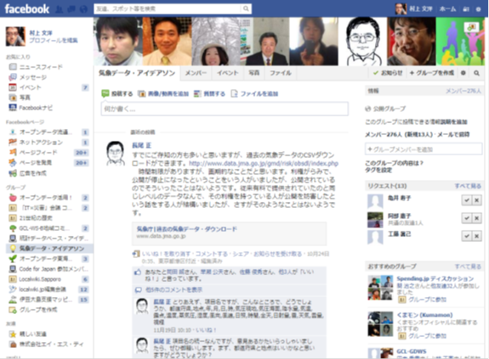
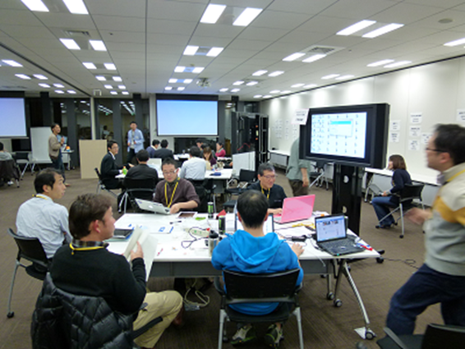
Meteorological Data Ideathon /Hackathon (2012)

Slide 12
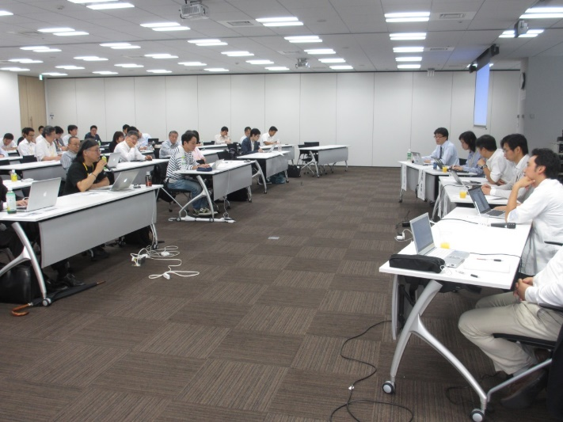
Open Data for Future

Slide 13
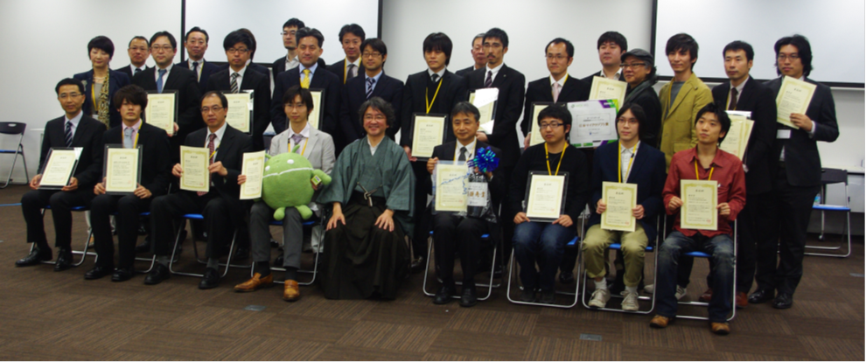
Japan Open Data Award（2012 & 2013）

Slide 14
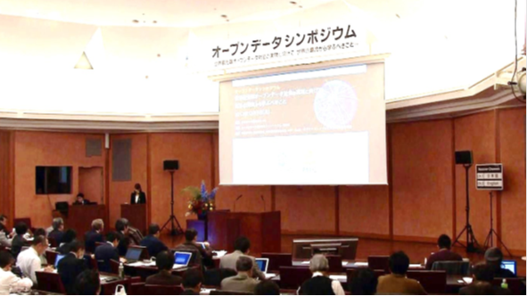
Open Data Symposium（2012 & 2013）

Slide 15
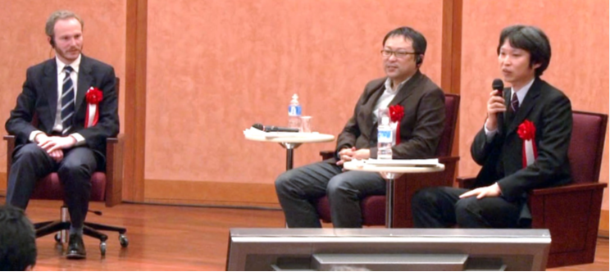
Open Data Symposium（2012 & 2013）

Slide 16
Open Data Application Contest http://www.opendata.gr.jp/2013contest/
Invite the public to join the application development that utilizes public data as open data created by seven kinds of demonstration experiments to promote utilization of the public data in private enterprise.
Seven categories: The local government administration information / social capital / sightseeing / disaster prevention / public transport / statistics information, data catalogue / hay fever related information
Acquisition API is based on the external specification for the Information promotion collaboration platform system

Slide 17
As a result of examination, the following works were awarded among 92 applications.
Prize | Applicant | Prize-Winning Application
Best | Hakuhodo i-studio | Mr. Pollen （kafunkun.com）
Excellent | jig.jp Co.,Ltd,Team megasaba | Photo Location Hunter !
Fine Work | Tokyo International University, Sato laboratory | odStatViewer
Technique ※ | Code for Platinum Society | Base Application for Data Creators who Support the Platinum Society. LinkData.org
 | Interfaculty Initiative in Information Studies at Tokyo University, Nakao Laboratory | BeaconCast
 | Takashi Tokuda | Safety Compass for Kyoto City
Local Government Information Demonstration | Miyagi Technical HighSchool, | ～Disaster Prevention Bag for Information～ iSHelper
Social Capital Demonstration | HORIZON Co., Ltd | Application to Support the Visually Impaired
Tourism Demonstration | Kyoto Flower Tourism Limited Company | Local Navi
Disaster Prevention Demonstration | Super Dimension Japan GIS | Tsunami Evacuation Navi
Public Transportation Demonstration | Yukihiko Shigesada | 3DYamanote Line Clock
Statistics and Catalogue Demonstration | Ayaka Okada | Hello Town!
Hay Fever Related Information Demonstration | Hakuhodo i-studio | Mr. Pollen （kafunkun.com）※Double Prize Winning with the Best Prize

Slide 18

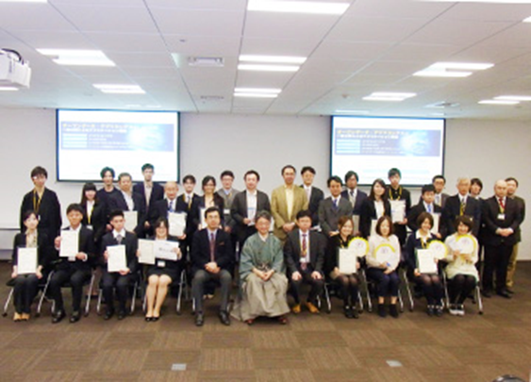
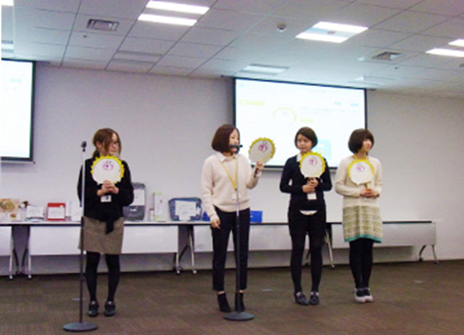

Open Data Application Contest
会場風景2

Slide 19
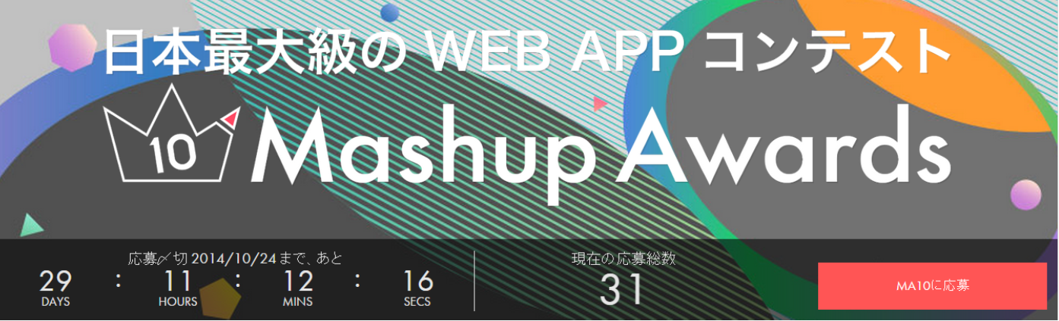
Mashup Awards 10
http://mashupaward.jp/
Establish a new prize "Open Data Section " from 2014.
Open Data Promotion Consortium participates as an administration partner with Cabinet Secretariat IT Strategic Headquarters, MIC, METI and JIPDC.
Choose either “business section” or "trial model section" and apply.
Recruit the open data partner (data provider)
The work for other contest is acceptable.

Slide 20
Introducing activities at international arena
“Internet Governance Forum 2013”
  Announcing the situation of domestic open data strategy development, major projects and activity targets on a theme called “Open data developments in Japan”.
ITU-T Workshop: “Internet of Things – Trends and Challenges in Standardization”, 2014
  Calling for needs of standardization that connects IoT field to the open data field by introducing the demonstration experiment in the workshop held by standardization organization ITU-T of the United Nation.
OECD: “Global Forum on the Knowledge Economy 2014”
  http://www.oecd.org/sti/global-forum-knowledge-economy-2014.htm
20th ITS World Congress Tokyo 2013
  Introducing activities of the consortium in Japan in the session “Data Integration Issues and Standardization - Creating Connected World Around Vehicles”.

Slide 21
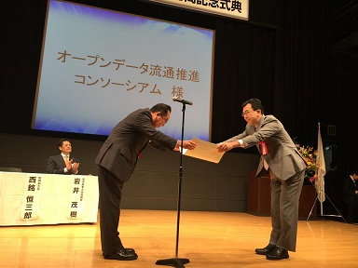
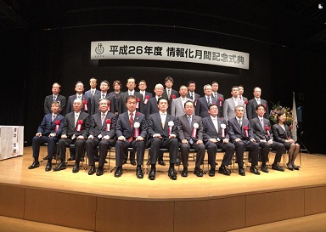
Information Promotion, Minister for Internal Affairs and Communications award (2014)
Open Data Promotion Consortium received Minister for Internal Affairs and Communications award as contribution to information promotion (corporate/group sector) on October 6, 2014.
  By contributing to the development of “Basic concept of data release of ministries for secondary use promotion (Guideline)” and "Government Standard Terms of Use" (version 1.0) which was the model of the new terms of use of the homepage for each ministry, it led the promotion of the open data strategy of our country with cooperation for our governmental policy making related to the open data.

Slide 22
Expectation to the new corporation (VLED)

Slide 23
Realization of original purpose of open data

Slide 24
（１）
Open data as a new public-private cooperation model
Government 2.0

Slide 25
（２）
Economic activation by open data
New information business model by public open data
Start up of the big data business
One of economical measures with less money

Slide 26
（３）
Transparency of public administration and local government
Data Journalism

Slide 27
2020
Olympics / Paralympics in Tokyo

Slide 28
2012 London Olympics is open data Olympics

Slide 29
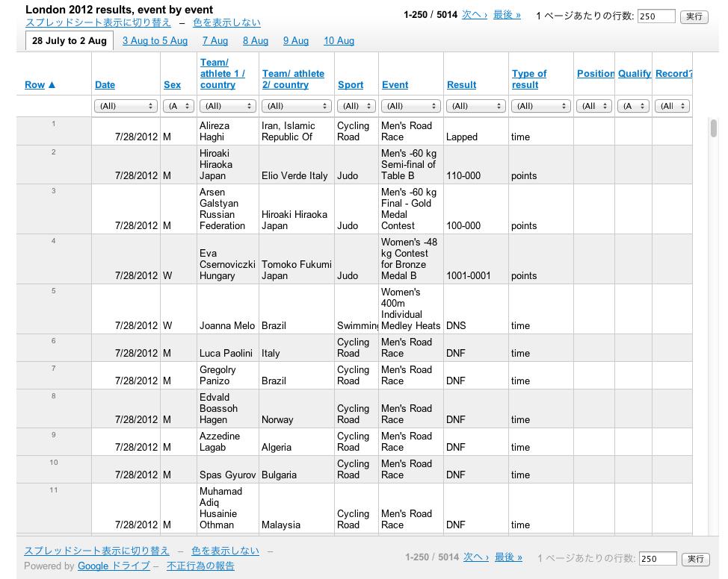
All game results become open data

Slide 30
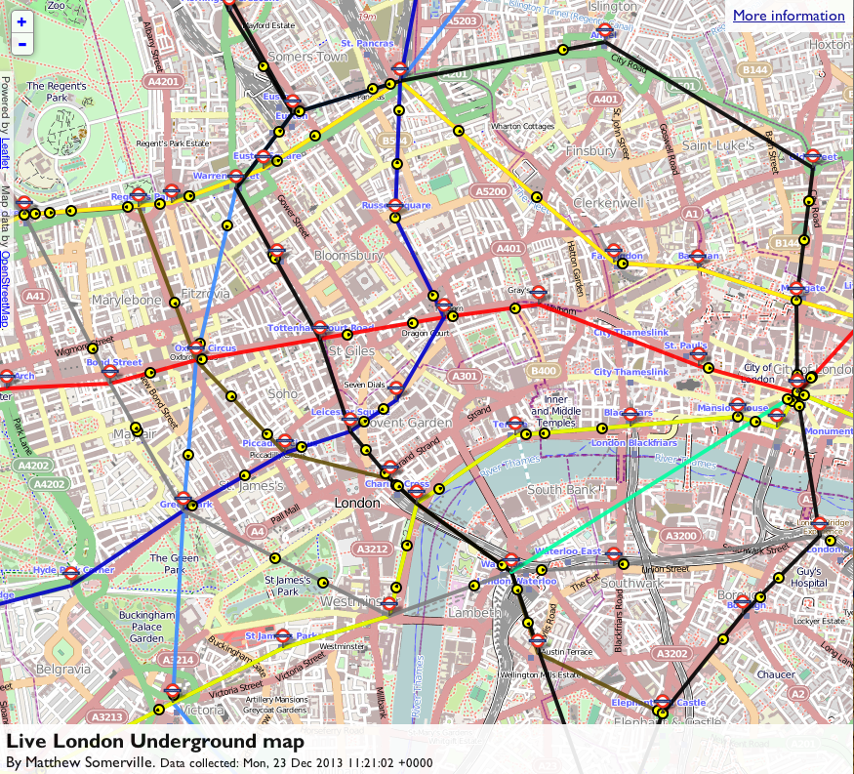
Urban development with utilization of open data（Live Train Map）

Slide 31
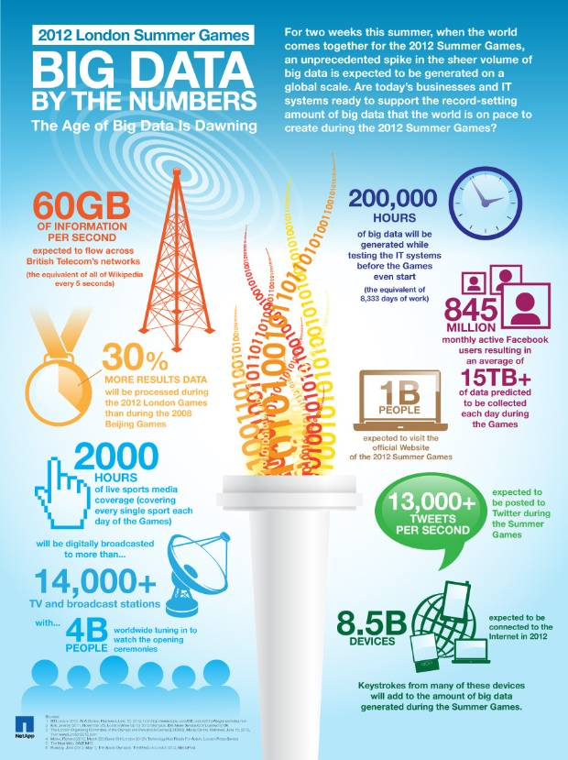
Scale of the data generated by the London Olympics
60 gigabytes flow per second

Slide 32
Community development with open data utilization
“O Mo Te Na Shi”
a leading model of the information society of our country after 2020

