Slide 2
Iwao kobayashi
Information Architect, Producer, Designer
Vice-President of NPO linked Open Data Initiative
Director of Yokohama Open Data Solution Development Committee
Code for Yokohama
Member of General Incorporated Association "Vitalizing Local Economy Organization by Open Data & Big Data"
ODI Osaka Leading Team
Twitter:@iwao

Slide 3
Members of the Board of Directors
President Hideaki Takeda
Vice-President Kazuteru Oumukae
Vice-President Iwao Kobayashi
Director Seiji Koide
Director Hhumihiko Katou
Director Tetsuo Kamura
Director Toru Takahashi
Director Yoshiaki Hukami
Director Huyuko Matsumura
Auditor Makoto Okamoto

Slide 4
Major Activities
Research & Study Project on Linked Open Data & Open Data
Organizing Lecture Courses and Symposiums
Support to Linked Open Data & Open Data Related Projects
Assessment of Open Data Initiatives

Slide 5
What’s LOD?

Slide 6
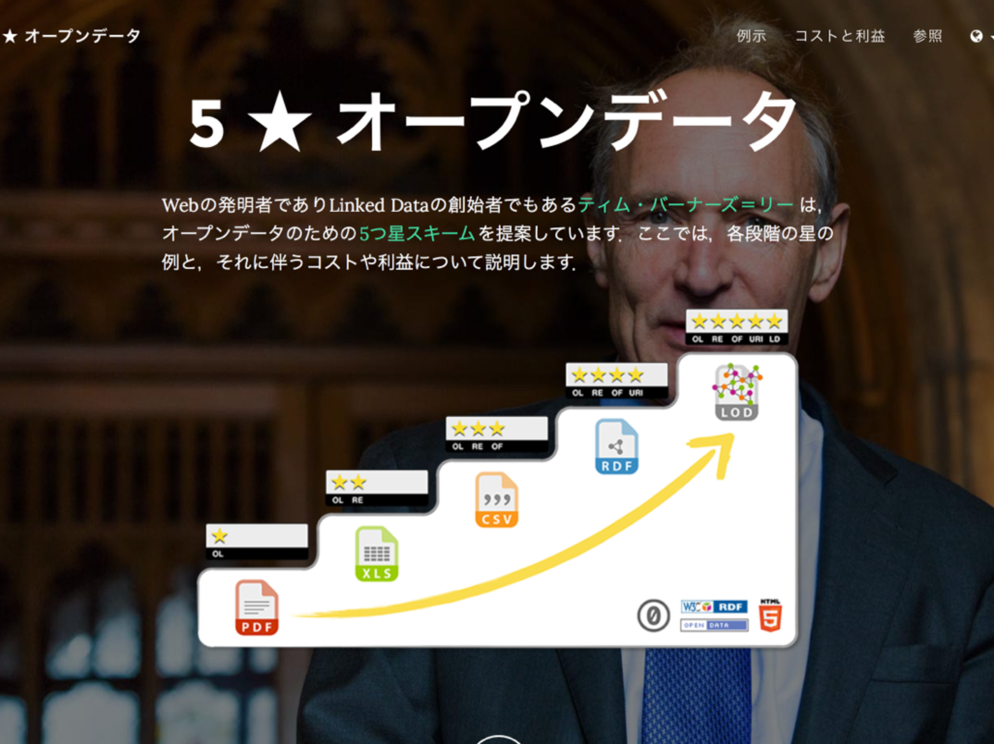

Slide 7
If Developed into Resource Description Framework (RDF),
is it Five-Stared ?

Slide 8
Is RDF a Kind of XML?

Slide 9
I Do Not Understand
the Meaning of LOD Link

Slide 10
I Do Not Know How
to Use SPARQL

Slide 11
Please Come
and Talk with Us in LODI

