Slide 1
Open Data Symposium 2015
Introducing VLED Activities

Slide 2
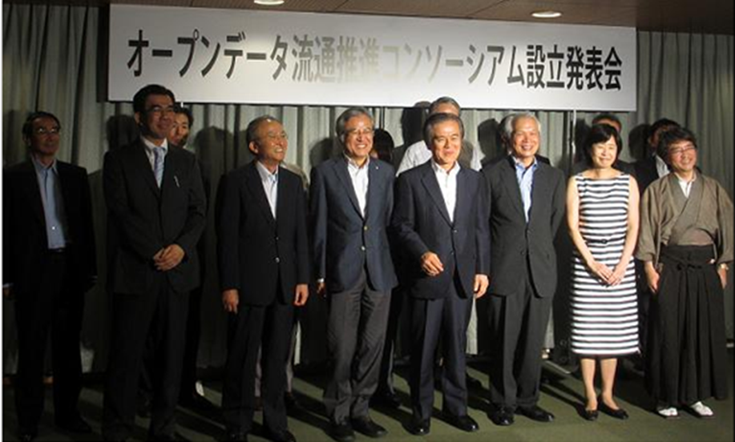
2012-07
Open Data Distribution Promotion Consortium Established

Slide 3

2014-10
Renamed as VLED When Incorporated as General InCorporated Association

Slide 4
VLED＝Pronounced as VUILEDDO. Officially Named as General Incorporated Association "Vitalizing Local Economy Organization by Open Data & Big Data” As the Name is so Long, please Remember it as VLED

Slide 5
VLED Major Activities

Slide 6
Committee Activities
・Technical Committee
・Data Governance Committee
・Utilization & Diffusion Committee
・2020 Open Data city Promotion Committee
→ Preparation of Open Data Guide
→ Examination of Government Standard Utilization Rules, etc.

Slide 7
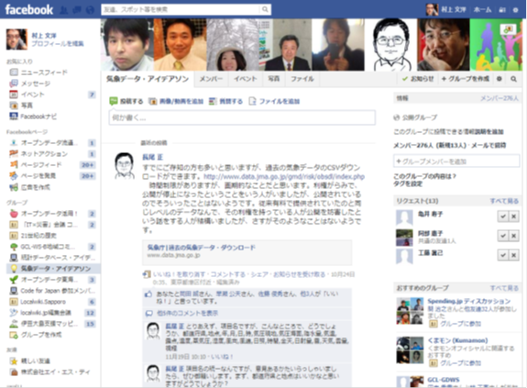
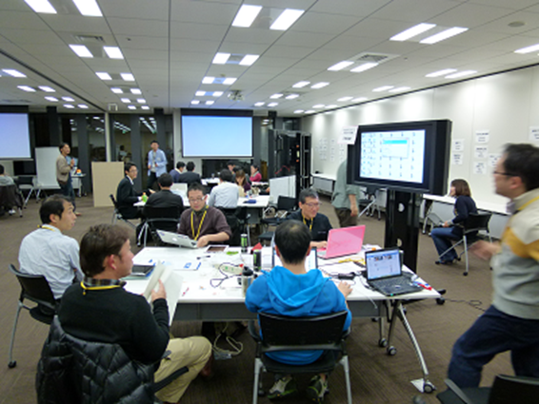
Ideathon/Hackathon
Climate Data Ideathon/Hackathon

Slide 8
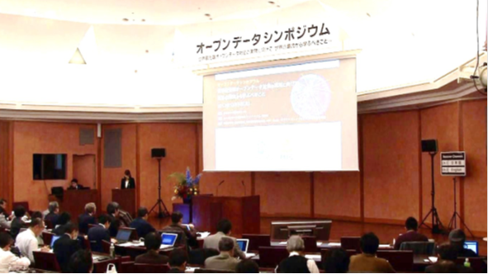
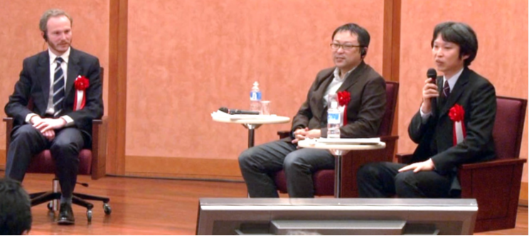
Symposium
2012 ＠University of Tokyo Ito Memorial Hall
2013 ＠University of Tokyo Ito Memorial Hall
2014 ＠Hitotsubashi University Hitotsubashi Auditorium
2015 ＠ACROS FUKUOKA International Congress Hall

Slide 9
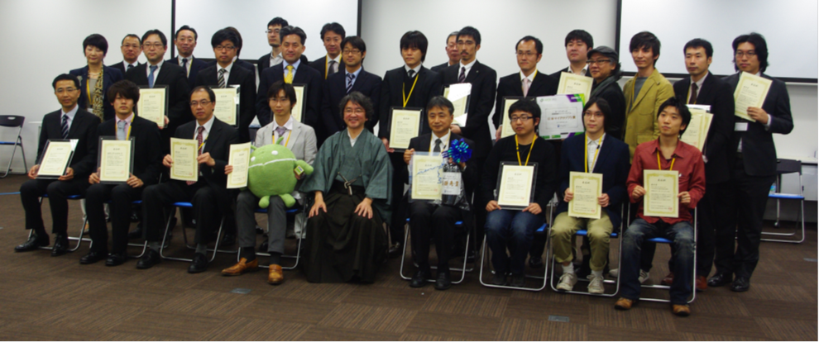
Award Winners

Slide 10

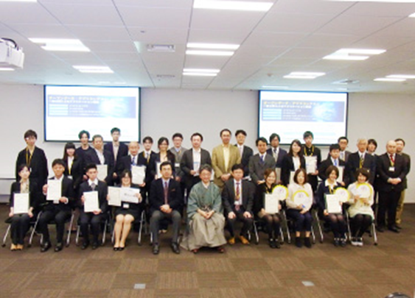
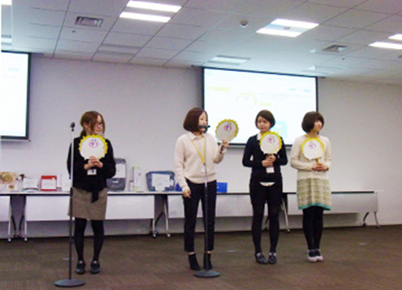

Appli Contest

Slide 11
Training Course For Local Government Officials

Slide 12
Training For Local Government Official

Slide 13
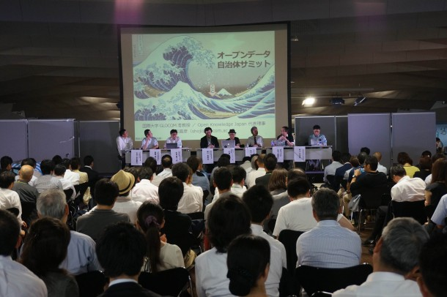
We Support and Sponsor actively Events in Various Regions
Example：Open Data Local Government Summit @ Yokohama

